Slide 1
Pacific constitutional networking conference University of South Pacific, Port Vila, Vanuatu 23rd -25th November 2016 The Need For The Reviewing And Monitoring Of Supreme Court Judgements In The Papua New Guinea Judiciary By: Ms Netty Daemuna PNGC&LRC
CONSTITUTIONAL AND LAW REFORM COMMISSION

Slide 2
OUTLINE
Background
Introduction
Aim of Paper
Methodology
Way Forward

Slide 3
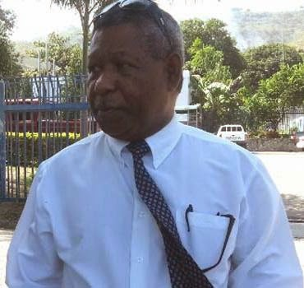
Background
“No man is above the law”
MEDIA STATEMENT. By Thomas Eluh, Assistant Commissioner of Police – Suspended 2014.

Slide 4
INTRODUCTION
Independence of the Supreme Court of PNG
Special Functions of the SC as per Constitution
1. original jurisdiction to the exclusion of other courts, as to any question relating to the interpretation or application of any provision of a Constitutional Law. ( s.18 PNG Constitution).
2. Together with the NC, develop and apply Underlying Law in a manner that is appropriate to the circumstances of the country from time to time, except insofar as it would not be proper to do so by judicial act. (Sch. 2.3.4.Judicial development of the underlying law.)

Slide 5
INTRODUCTION CONTINUE
Case analysis
SCM No. 26 of 2015 re Hon. Ano Pala Vs Cosmas Bidar, Geoffrey Vaki
Supreme Court was in effect rightfully exercising its inherent power in determining a decision on the question of fact and law with regards to the above decision respectively. However within the same decision it had refrained the police from arresting the appellant and other named herein (in the end bringing a stop to further investigation), which shouldn’t be the case because the Police is a state service established under s188 (1) b of the Constitution and is subject to the control of the NEC through a Minister. Therefore Courts cannot interfere with the constitutional duty and function of the police as provided for in s197 (2) of the Constitution.

Slide 6
Aim Of Paper
Create a Discussion paper that will generate discussion around the following ideas.
1.
Is there is need for clarify as to where the jurisdiction of the Supreme Court ends?
2.
who is to monitor the judgements and development of the underlying law?
( note: Taking into consideration CLRC’s special function sch. Sch. 2.6.14)

Slide 7
METHODOLOGY
Literature and desktop review
SC case analysis ( cases btwn 2012-2016)
( Sources: Paclii, Underlying Law Journal)
Commentaries
(sources : Media, interviews etc)

Slide 8
Methodology cont
3. DURATION
12 months (August 2016- August 2017)
4. RECOMMENDATION
- tool to initiate discussion amongst the courts, s19 offices, statutory bodies with the law and justice sector and other related or interested stakeholders who will be directly or indirectly be affected by the outcome of this discussions.

Slide 9
WAY FORWARD
1- The proposed discussion paper will have to conform with the CLRC processes.
- urgency and severity of the matter.
- political sensitivity/constitutionality.
2. Issues paper

Slide 10
End of Presentation
Ms Netty Daemuna
Legal Officer
Papua New Guinea Constitutional and Law Reform Commission.
PNG

