Slide 1
Pacific Constitutions Network (PCN)
Presentation on Constitutions and Religion
Tuvalu’s current legal framework concerning restrictions on religious bodies
Notes:
Good afternoon Olgeta,
My name is Corinna and I will be presenting a brief discussion into the current legal framework concerning restrictions on religious bodies- the case of Tuvalu.

Slide 2
Why did we opt for such Restrictions on religious bodies
The paramount consideration for the safeguard of traditional systems and values of Tuvalu and the emphasis on ‘Falekaupule function and role in traditional leadership
Impact of post Teonea v Kaupule Nanumaga TVCA 2012
The myth about Tuvalu being a Christian nation with one particular denomination ‘Ekalesia Kelisiano Tuvalu (EKT) being the country’s Church

Slide 3
LEGAL FRAMEWORK
CONSTITUTION
Constitution (Recognition of Traditional Standards, Values and Practices) Amendment Act 2010
FALEKAUPULE ACT 1997
RELIGIOUS ORGANISATIONS RESTRICTION ACT 2010
Notes:
Like any other Pacific Island country, Tuvalu puts a lot of emphasis on the recognition of traditional standards, Values and Practices
In its Constitution, the Preamble put

Slide 4
Constitution
Freedom of Belief
Section 23 ‘No one shall be hindered in the exercise of his freedom of belief
‘Belief’-
  (a) freedom of thought, religion and belief; and
(b) freedom to change religion or belief; and
(c) freedom, either alone or with others, to show and to spread, both in public and in private, a religion or belief, in worship, teaching, practice and observance.

Slide 5
Constitution (Recognition of Traditional Standards, Values and Practices) Amendment Act 2010
Three main purposes:
To protect island communities’ traditional interests
Offer powers necessary to pose restrictions on certain constitutional freedoms
Afford legal recognition for traditional practices of island communities
Section 5- Amendments to the Constitution

Slide 6
Falekaupule Act 1997
Section 39- Duty to discharge functions
(1) It shall be the duty of every Falekaupule established by this Act —
(a) to discharge the functions conferred upon Falekaupule by or under this
or any other Act; and
(b) generally, through the Kaupule, to maintain order and good government
and promote development within the area of its authority.

Slide 7
Religious Organisations Restriction Act
2010
Prohibitions
- Section 4
‘Except with the prior approval of a Falekaupule’
‘Conditions as Falekaupule may impose’

Slide 8
Religious Organisations Restriction Act
2010
Procedural Consideration
1.Opportunity to address the Falekaupule on the beliefs and practices of the religious organisation
2. The equilibrium balance-
Duty bearers = Rights holders

Slide 9
Legal Challenges
Validity and the application of our legal framework
Socio-economic impact of such restrictions on the general public, interest groups, communities -
The concept of ‘Decision of the Falekaupule is final and shall not be question in any court of law (ROR Act 2010 section 6)’
Mechanism open to influence (political/social/cultural)
Escalating in number of public outcry and religious protests/ petitions

Slide 10
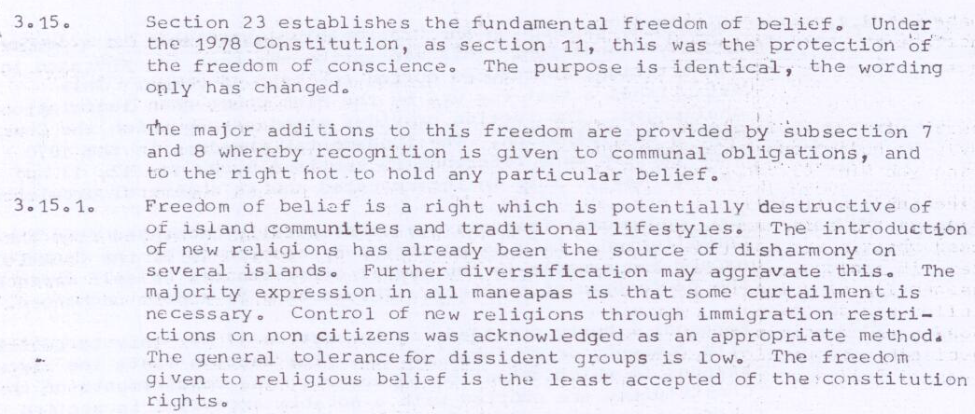
History of Constitutional Review Committee
1982 -1986 Review Findings

Slide 11
Work in Progress for CRC
May/June 2016 Constitutional Review Consultation
Budget 2016-2017
Allocation AU$800,000
National CRC public consultations on all islands

