Slide 1
The Fate of Political Party and Government Strengthening Laws in Western Melanesia
Pacific Constitutions Network Conference, Emalus Campus, Port Vila, 23-25 November 2016
Jon Fraenkel
Professor of Comparative Politics
Department of Political Science & International Relations
School of History, Philosophy, Politics & International Relations
Victoria University of Wellington
PO Box 600
Wellington 6140
New Zealand

Slide 2
One Verdict on South Pacific constitutionalism
‘As the modern constitutions of South Pacific states remain divorced from traditional order so too does the origin of law in the will of the people remain, in large part, a fiction. This issue is at the heart of the failure of the legitimacy of the rule of law in the Pacific Island states’ (Hassall)
Has the legitimacy of the rule of law ‘failed’ in the Pacific Islands states?
Are modern Pacific Island constitutions ‘divorced’ from the traditional order?
More complex question: Is the ‘origin of the rule of law’ anywhere truly grounded in the ‘will of the people’?

Slide 3
Trump Vs Clinton

Slide 4
What is a Constitution?
‘a formal contract drafted in the name of “the people” for the purpose of establishing and controlling the powers of the governing institutions of the state’
(Martin Loughlin, ‘What is Constitutionalisation?’, in Loughlin, M, McCormick, JP & Walker, N. The Twilight of Constitutionalism?, Oxford University Press, 2010)

Slide 5
One Verdict on South Pacific constitutionalism
‘As the modern constitutions of South Pacific states remain divorced from traditional order so too does the origin of law in the will of the people remain, in large part, a fiction. This issue is at the heart of the failure of the legitimacy of the rule of law in the Pacific Island states’ (Hassall)

Slide 6
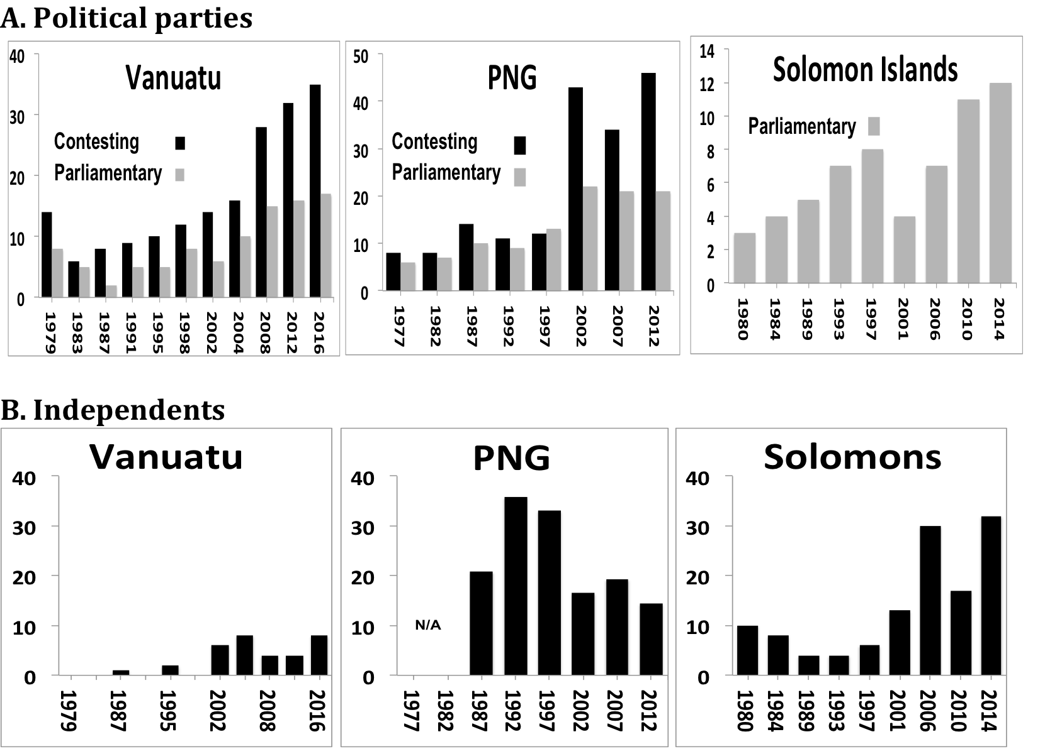
Notes:
Vanuatu – continuous splintering from ‘mother parties’
PNG – Bizarre impact of OLIPPAC – increase both contesting and parliamentary
Solomon islands – affiliations particularly uncertain 1990s & 2001
Independents
Vanuatu -= neg’igible at start (strongest party system in independent Pacific)
PNG big increase 1990s, but fall under OLIPPAC (connected to party proliferation)
Solomon Islands – Big increase new millennium – but data sketchy – esp SINGUR./SIAC, substantial change 2014 (unforeseen consequences 2014 Political Parties Act)

Slide 7
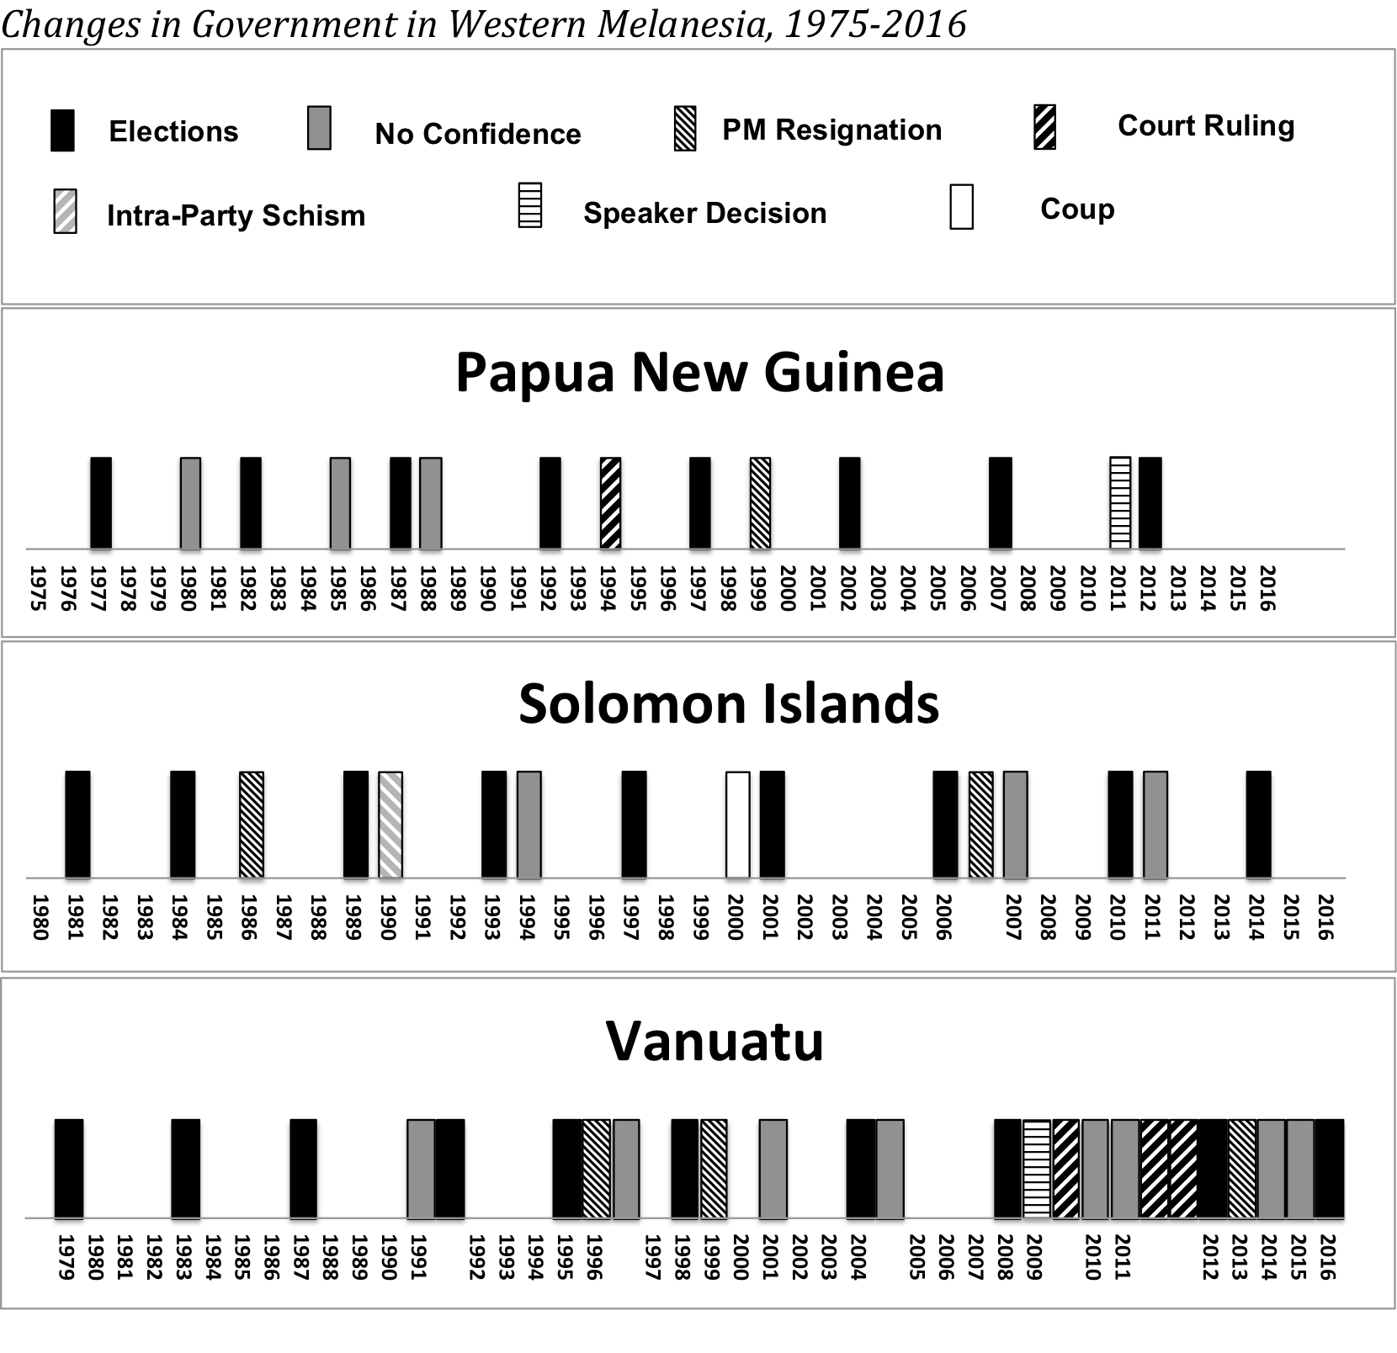
Notes:
Changes in government far more regular in Vanuatu than PNG or Solomon Islands
3 successful no confidence votes PNG, but also Skate resignation 1999 (to avoid NC), 94 court ruling vs Wingti, and Speaker Nape decision 2011
Solomon Islands – 3 successful no confidence votes, but 2 resignations, Mamaloni’s volte face of 1990 and illegal ousting of Ulufa’alu 2000
Vanuatu – 8 successful NC votes, 3 PM resignations to avoid NC votes, 3 court enforced government changes, one speaker decision.

Slide 8
Laws to Strengthen Political Parties …. or Governments?
2001-3 Organic Law on the Integrity of Political Parties and Candidates (Papua New Guinea)
2014 – Political Parties Integrity Act (Solomon Islands)

Slide 9
PNG - 2001-3 Organic Law on the Integrity of Political Parties and Candidates (OLIPPAC)
(i) Commission and an Office of the Registrar of Parties and Candidates entrusted with recording and monitoring MP affiliations, de-registering non-qualifying parties and facilitating state financing of parties
(ii) ‘largest party’ after a general election has first opportunity to nominate a Prime Minister;
(iii) rules regulating MP movements on the floor of parliament - an MP who backed a successful candidate for the Prime Ministerial portfolio was obliged to stick with that choice in any a) vote of no confidence, b) budgetary vote and c) vote on a constitutional amendment, unless a change was in accordance with a party resolution. An MP could abstain in such a vote, but not (as an individual) vote against his or her initial choice of Prime Minister
Legal Penalty – reference to Ombudsman/Leadership Tribunal > loss of seat
(iv) Weak/tokenistic provisions to encourage parties to nominate women as candidates
Provision (iii) was found to be unconstitutional by the PNG Supreme Court in mid-2010. Other provisions survive.

Slide 10
Notes:
Changes in government far more regular in Vanuatu than PNG or Solomon Islands
3 successful no confidence votes PNG, but also Skate resignation 1999 (to avoid NC), 94 court ruling vs Wingti, and Speaker Nape decision 2011
Solomon Islands – 3 successful no confidence votes, but 2 resignations, Mamaloni’s volte face of 1990 and illegal ousting of Ulufa’alu 2000
Vanuatu – 8 successful NC votes, 3 PM resignations to avoid NC votes, 3 court enforced government changes, one speaker decision.

Slide 11
Notes:
Vanuatu – continuous splintering from ‘mother parties’
PNG – Bizarre impact of OLIPPAC – increase both contesting and parliamentary
Solomon islands – affiliations particularly uncertain 1990s & 2001
Independents
Vanuatu -= neg’igible at start (strongest party system in independent Pacific)
PNG big increase 1990s, but fall under OLIPPAC (connected to party proliferation)
Solomon Islands – Big increase new millennium – but data sketchy – esp SINGUR./SIAC, substantial change 2014 (unforeseen consequences 2014 Political Parties Act)

Slide 12
2014 – Political Parties Integrity Act (Solomon Islands)
- Ahead of the 2014 general election, PM Gordon Darcy Lilo established a PNG-style political parties commission, together with state financing mechanisms, and rules regulating the conduct of parties and coalitions after general elections & nomination of a Prime Minister
- No effort to regulate MP movement on the floor of the house (NB - PNG 2010 Supreme Court case)
No constraints on independents

Slide 13
2014 – Political Parties Integrity Act (Solomon Islands)
Schedule 2, Pt. 1:
2. ‘After a general election, the parliamentary party leaders of the political party in the Coalition of Political Parties with the highest number of seats in Parliament shall be the leader (“Leader”) and … be nominated as Prime Minister when the Governor General calls for nomination for the election of the Prime Minister…..’
14. If a political party to the Coalition changes its parliamentary leader, the following rules shall apply
(a) if the parliamentary party leader is the Prime Minister
(i) the political party shall recommend to the Leader that he or she resign as Prime Minister, and
(ii) After the Prime Ministers resignation, the members of parliament who are members of the Coalition, shall nominate to the Governor –General … the new parliamentary leader of the political party as a candidate for the election as Prime Minister .... (my underlining)

