Slide 1
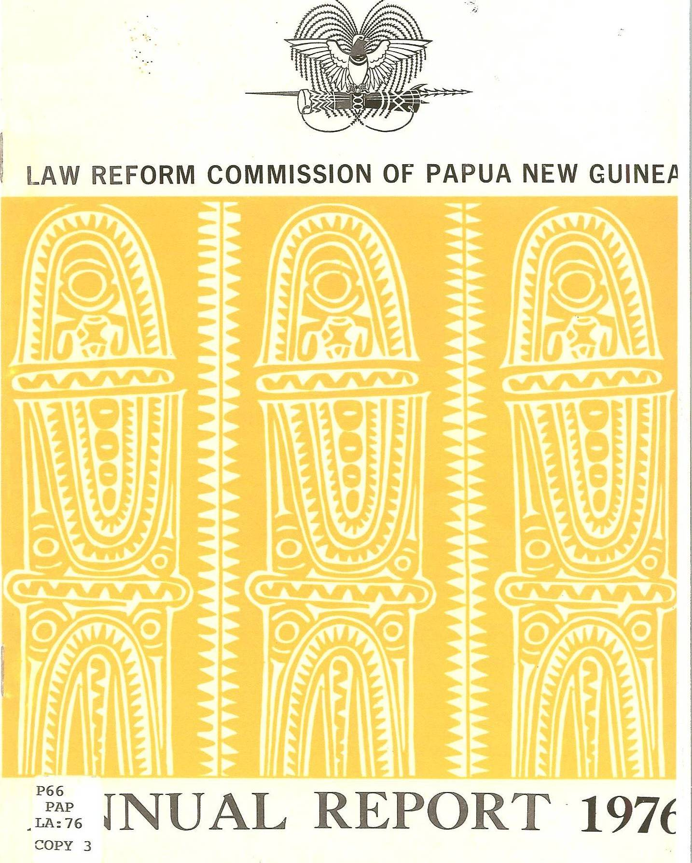
Challenges of Constitutional Reforms in the 21st Century
INDEPENDENT STATE OF PAPUA NEW GUINEA
Constitutional and Law Reform Commission
Dr Eric Kwa, PhD
Secretary CLRC
(Pacific Constitutions Conference, Port Villa, Vanuatu
23-25th November 2016)

Slide 2
Outline
Introduction
State of the Pacific Constitutions
Rhetoric versus Reality
Constitution and Development
Implementing Constitutional Provisions
Reforming Constitutions
Why Reform the Constitution?
Reforming the Constitution for Who?
Cost of Reforming the Constitution
Sustaining the Rule of Law
Conclusion

Slide 3
Introduction
In 1998, a commentator on Pacific Constitutions complained that:
“Pacific Constitutions are
unaccommodative of new trends and
ideas and URGENTLY NEEDED REVIEW
AND REFORM ”
(Wickliffe, I (1998))
This morning I present to you my thoughts on the review and reform of Pacific Constitutions with particular emphasis on my experience in PNG

Slide 4
State of Pacific Constitutions
The countries of the South Pacific and particularly the three big States in the region (PNG, Fiji, SI) have been criticised over the years for all kinds of things including:
1. corruption
2. political instability
3. low HDI, etc
However, my good friend, Emeritus Prof Ted Wolfers always encourages me with this one basic truth:
Pacific Constitutions and particularly PNG, have remained
resilient and unbroken (apart from Fiji) for over 40
years
Pacific Constitution have been and continue to be the cornerstone of Pacific nations and their development as nation Sates.

Slide 5
Rhetoric v Reality
The political and ethnic tensions in PNG, SI, Fiji, Tonga and Vanuatu highlight the reality of a changing modern contemporary society where the struggle between traditional norms and values clash with modern ideals
A statement from the Founding Father of PNG, Grand Chief, Sir Michael Somare amplifies the point:
“My aim for independence was for a united Papua
New Guinea, where everyone was equal and happy”
The guiding principle of the Pacific independence Constitutions was – unity!
Is the unity of our people still guaranteed under our independence Constitutions?

Slide 6
Constitution and Development
There is little discussion about the role of Constitutions in national development
Commentaries on development push National Constitutions to the corner of the debate as bygone monoliths
For Pacific Island Countries the nexus between this law and development is critical
Constitutions do influence development outcomes significantly

Slide 7
Implementing Constitutional Provisions
Are Pacific Constitutions being fully implemented?
The classic example of the Constitution of Kingdom of Tonga answers this question:
It is the oldest Constitution in the region
has been in existence since 1875
The proponents of the Transplantation Theory argue that it’s hard to implement Pacific Constitutions
This may be true, but the Pacific Constitutions have, are, and continue to serve their purpose – national unity and development
The existence of Pacific Island states manifest the strength and character of their Constitutions

Slide 8
Reforming Constitutions
Do we need to reform Constitutions?
Given that most Pacific Constitutions are descriptive, reviewing them often to keep pace with the change in society is imperative
The framers of the Pacific Constitutions were mindful of this reality and so made provisions for amendments to the Constitution
Example: PNG Constitution ss12-17

Slide 9
How do we Reform Constitutions?
There are several ways Constitutions are reformed. These include:
1. Constitutional Amendment
2. Judicial pronouncements
3. Legislative reforms
In most Pacific jurisdictions, observers focus more on the two former methods than the third

Slide 10
Why Reform the Constitution?
The following reasons may be offered:
1. Cater for new and emerging ideas
(external and internal pressures)
2. Change in Government (coup)
3. Change in Government agendas

Slide 11
Reforming the Constitution for Who?
If the three main reasons for reforming the Constitution are:
1. Cater for new and emerging ideas
(external and internal pressures)
2. Change in Government (coup)
3. Change in Government agendas
THEN IN WHOSE INTEREST IS THE
CONSTITUTION BEING REFORMED?
The main concern for everyone should be “the Change in Government agendas” or the elitist agendas

Slide 12
Cost of Reforming the Constitution
What is the cost of reforming the Constitution?
The answer depends on the method adopted to push the reform
If Constitutional Amendment or Legislative reforms require public participation - its expensive (in PNG about US$3 million)
If Constitutional Amendment or Legislative Reform is undertaken by State Institutions (in PNG about US$10,000 – 50,000)
If by Judicial pronouncements (in PNG about US$100,00 -500,00)
So who will bear the cost???

Slide 13
Sustaining the Rule of Law
Sustaining constitutionalism means sustaining the Rule of Law
As the dust of the political impasse of 2011 in PNG settled one commentator observed that:
Many commentators raised fears on the
rule of law in the country and the need for
its preservation (Bal Kama, 2013)
This fear should be everyone’s concern
However, Pacific Island States have shown maturity and resilience in ensuring that their Constitutions remain supreme – as the highest law of the land

Slide 14
Conclusion
Another friend of mine, Prof Graham Hassall wrote:
As the modern constitutions [of South Pacific states] remain divorced from traditional order so too does the origin of the law in the will of the people remain, in large part, a fiction. This issue is at the heart of the failure of legitimacy of the rule of law in Pacific island states (Quote from McFarlane 2014)
In my view Pacific Island countries have matured over time to move away from ‘constitution’ to ‘constitutionalism’
Pacific Constitutions continue to play a pivotal role in maintaining unity amongst the diverse peoples of the South Pacific within each of the State
Constitutional reforms that have taken place in Pacific Island countries have been smooth and consistent. Constitutional reform is ongoing and must be allowed for the good of the people and the nation State

Slide 15
For more information contact:
Dr. Eric Kwa, PhD
Secretary
Constitutional and Law Reform Commission
P O Box 3439
BOROKO
National Capital District
Ph: 325 2840/ 325 2862
Fax: 325 3375
Email ericlkwa@gmail.com

